Slide 2
Angular Dependency Injection & Services

Slide 3
Angular – Service
What is a Service
Service is a piece of reusable code with a focused purpose. A code that will be useed in many components across application.
What services are used for.
Features that are independent of components such a logging services
Share logic or data across components
Encapsulate external interactions like data access

Slide 4
Angular – Service
Advantages of Service
Services are easier to test.
Services are easier to Debug.
We can reuse the service.

Slide 5
Angular – Service
Example: Create a Service
An Angular service is simply a JavaScript function. All we need to do is to create a class and add methods & properties. We can then create an instance of this class in our component and call its methods.
One of the best uses of services is to get the data from the data source.

Slide 6
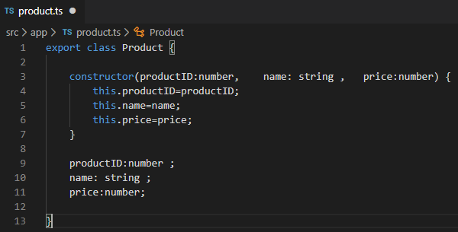
Angular – Service
Create a new file under the folder src/app and call it product.ts
The Product class above is our domain model.

Slide 7
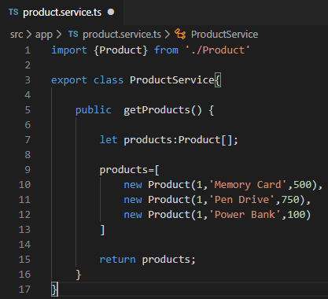
Angular – Service
Product
Next, let us build an Angular Service, which returns the list of products.
Create a new file under the folder src/app and call it product.service.ts

Slide 8
Angular - Service
First, we have imported the Product
We have created the ProductService class and exported it.
We have created a getProducts method, which returns the collection of the products. In this example, we have hard coded the products. In real life, you would send an HTTP request to your back-end API to get the data

Slide 9
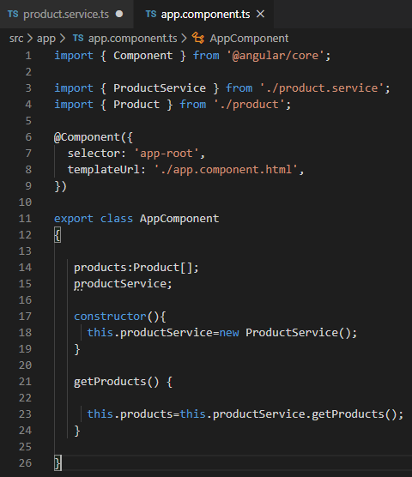
Angular - Service
Invoking the ProductService
The Next step is to invoke the ProductService from the component. Open the app.componet.ts and add the following code.
First, we have imported both Product & ProductService
In the constructor of the AppComponet, we have created the instance of the ProductSerivce
The getProducts method calls the getProducts method of the ProductService. The returned list of Products are stored in the local variable products

Slide 10
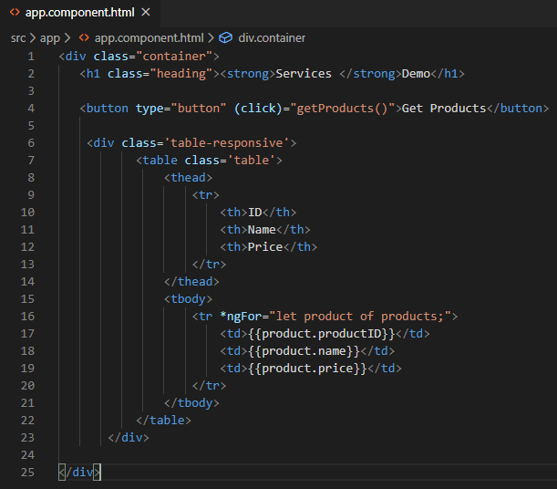
Angular – Service
Template
Open the app.component.html file and add the following code
We are using the bootstrap 3 to style our template here
We have added a button “Get Products”, which is hooked to getProducts method of the component class via event binding
We are displaying the returned products via ngFor directive.
Finally, run the code and click on the Get Product button and see the Products are displayed.

Slide 11
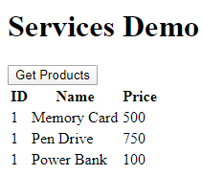
Angular – Service
Output

Slide 12
Angular – Service
Injecting service into component
In the example, we instantiated the productService in the Component directly as shown below.
Directly instantiating the service, as shown above, has many disadvantageous
The ProductService is tightly coupled to the Component. If we change the ProductService class definition, then we need to update every code where service is used
If we want to change ProductService with BetterProductService, then we need to search wherever the ProductService is used and manually change it
Makes Testing difficult. We may need to provide mockProductService for testing and use the ProductService for Production.

Slide 13
Angular – Dependency Injection
What is Dependency
We built a ProductService in the Angular Services. The AppComponent is depends on the ProductService to provide the list of Products to display.
In short, the AppComponent has a Dependency on ProductService.
What is Angular Dependency Injection
Dependency Injection (DI) is a technique in which we provide an instance of an object to another object, which depends on it. This is technique is also known as “Inversion of Control” (IoC).

Slide 14
Angular – Dependency Injection
Let us look at the ProductService, returns the hard-coded products when getProduct method.
We instantiated the productService directly in our component

Slide 15
Angular – Dependency Injection
Our Component Class has now tied one implementation of ProductService. It will make it difficult to reuse our component.
It is hard to test this Component as it is difficult to provide the Mock for the ProductService. For Instance, what if we wanted to substitute out the implementation of ProductService with MockProductService during testing.
What if ProductService depends on another Service. And then we decides to change the service to some other service. Again we need to search and replace the code manually
We would make our ProductService singleton so that we can use it across our application.

Slide 16
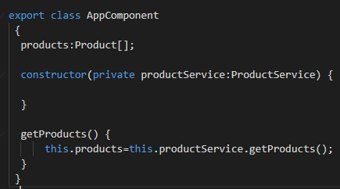
Angular – Dependency Injection
To solve all these problems. Move the creation of ProductService to the constructor the AppComponent class as shown below.
Now our AppComponent does not create the instance of the ProductService. It just asks for it in its Constructor. The AppComponent is now decoupled from the ProductService. We can pass ProductService, BetterProductService or MockProductService. The AppComponent does not care.

Slide 17
Angular – Dependency Injection
Why use Dependency Injection
AppComponent is now easier to Test.
AppComponent is not dependent on a Particular implementation of Service anymore.
Reusing of the component is becomes easier.
Dependency injection pattern made our AppComponent testable, maintainable etc.

Slide 18
Angular – Dependency Injection
Angular Dependency Injection Framework
Angular Dependency Injection framework implements the Dependency injection Pattern in Angular. It creates & maintains the Dependencies and injects them into the Components or Services which requests for it.
Parts of Angular Dependency Injection Framework
There are five main parts of the Angular Dependency injection Framework.
Consumer
The Component that needs the Dependency. In the above example, the AppComponent is the Consumer
Dependency Injection
The Service that is being injected. In the above example the ProductService is the Dependency

Slide 19
Angular – Dependency Injection
DI Token
The DI Token uniquely identifies a Dependency. We use DI Token when we register dependency.
Providers
The Providers Maintains the list of Dependencies along with their Tokens. The DI Token is used to identify the Dependency.
Injector
Injector holds the Providers and is responsible for resolving the dependencies and injecting the instance of the Dependency to the Consumer.

Slide 20
Angular – Dependency Injection
How Dependency Injection works in Angular
The dependencies are registered with the Provider. This is done in the Providers metadata of the Injector.
Angular Provides an instance of Injector & Provider to every Consumer.
Consumer when instantiated, It declares the Dependencies it needs in its constructor.
Injector reads the Dependencies from the constructor of the Consumer and looks for the dependency in the provider. The Provider provides the instance and injector, then injects it into the consumer. If the instance of the Dependency is already exists, then it is reused making the dependency singleton.

Slide 21
Angular – Dependency Injection
How to use Dependency Injection
First, In ProviderService, we need to register the dependencies with the provider. This is done in the providers metadata array of @Component decorator.
Next, we need to tell angular that our component needs dependency injection. This is done by using the @Injectable() decorator.
@Injectable() decorator is not needed, if the class already has other Angular decorators like @Component, @pipe or @directive etc. Because all these are a subtype of Injectible.
Since our AppComponent is already decorated with @Component, we do not need to decorate with the @Injectable
Notes:
@Injectible is also not needed if the class does not have any dependencies to be injected. However it is best practice is to decorate every service class with @Injectable(), even those that don’t have dependencies.

Slide 22
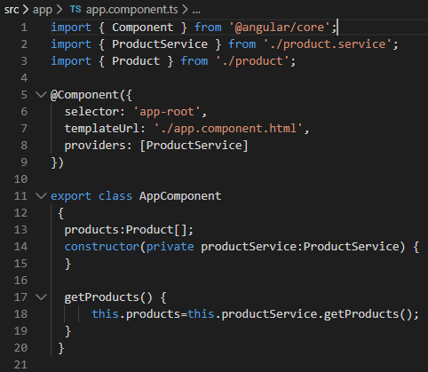
Angular – Dependency Injection
Next, our AppComponent needs to ask for the dependencies. This is done in the constructor as shown below.

Slide 23
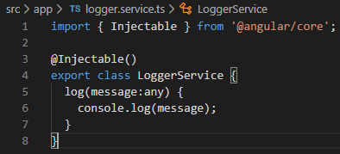
Angular – Dependency Injection
Injecting Service into Service
Let us build loggerService, which logs every operation into a console window and inject it into our ProductService.
Logger Service
Create the logger.service.ts and add the following code

Slide 24

Angular – Dependency Injection
Product Services
Now we want to inject this into our ProductService class
The ProductService needs loggerService to be injected. Hence the class requires @Injectible metadata
Next, In the constructor of the ProductService ask for the loggerService.

Slide 25
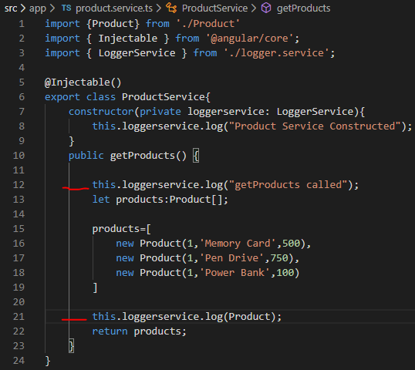
Angular – Dependency Injection
And update the GetProducts method to use the Logger Service.

Slide 26
Angular – Dependency Injection
Open the AppComponent Update the Providers array to include LoggerService.
Inspect on the Get Products button, will see the Console window updated with the Log messages

Slide 27
Angular – Dependency Injection
Using NgModule to Provide Dependencies
In the above example, we registered the dependencies in the Providers array of the component class. The dependencies are only available to the component where it is registered and to its child components.
To Make the dependencies available to the entire application, we need to register it in the root module.
Remove the providers: [ProductService,LoggerService], from the AppComponent and move it to the AppModule as shown below

Slide 28
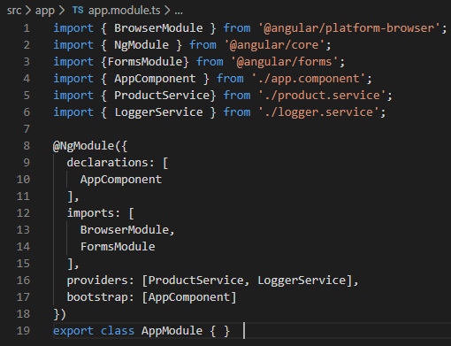
Angular – Dependency Injection
Providing the service in the root module will create a single, shared instance of service and injects into any class that asks for it.

Slide 29
Angular – HttpClient
HttpClient enables the communication between client and server through many available methods like get(), post(), put(), delete() etc. We will also add Error handling techniques using RxJS operators at one place in our service.

Slide 30
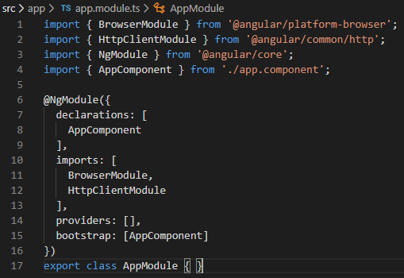
Angular – HttpClient
Import HttpClientModule in root module
Import HttpClientModule module from @angular/common/http package and add its entry in imports attribute of @NgModule.

Slide 31
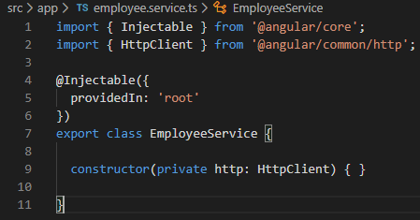
Angular – HttpClient
Inject HttpClient in service constructor
Now inject actual HttpClient service in service code as start using it.

Slide 32
Angular – RxJS
What is RxJS
The RxJS (Reactive Extensions Library for JavaScript) is a javascript library, that allows us to work with asynchronous data streams
The Angular uses the RxJS library heavily in its framework to implement Reactive Programming. Some of the examples where reactive programming used are
Reacting to an HTTP request
Value changes / Status Changes in Angular Forms
The Router and Forms modules use observables to listen for and respond to user-input events.
You can define custom events that send observable output data from a child to a parent component.
The HTTP module uses observables to handle AJAX requests and responses.

Slide 33
Angular – Observable
What is Observable
Observable converts the ordinary stream of data into an observable stream of data. It observes the stream of data and emits the value, complete or error signals to the consumers of the stream.
Observables are declarative. We define an observable function just like any other variable. The observable function executes only when someone subscribes to it.

Slide 34
Angular – Subscribers
The observable communicates with the observers using callbacks
The observer must subscribe with the observable to receive the value from the observer. While subscribing it optionally passes the three callbacks. next(), error() & complete().
The observable invokes the next() callback whenever the value arrives in the stream. It passes the value as the argument to the next callback. If the error occurs, then the error() callback is invoked. It invokes the complete() callback when the stream completes.
Observers/subscribers subscribe to Observables
Observer registers three callbacks with the observable at the time of subscribing. i.e next(), error() & complete()
All three callbacks are optional
The observer receives the data from the observer via the next() callback
They also receive the errors and completion events from the Observable via the error() & complete() callbacks

Slide 35
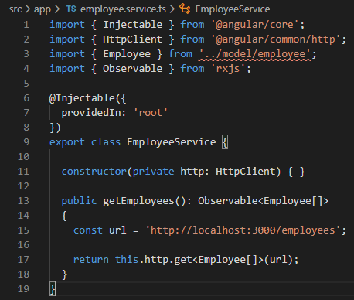
Angular – HttpClient
Create service which return Observable
We will consume the REST API created with REST mock server. Let’s edit the code of employee service class and return Observable from it.

Slide 36
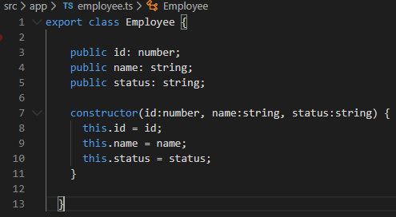
Angular – HttpClient
Above code, hits the REST API "/employees" and fetch employee array. It then return the employee array as observable collection. Any method can subscribe to it to listen data events on this array.
Employee is model class to store data.

Slide 37
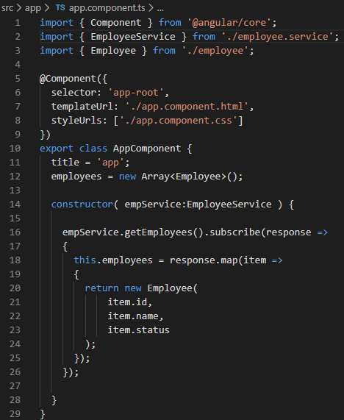
Angular – HttpClient
Create observer which subscribe to Observable
We will create subscriber in component file. It will read the data from observable array and assign to model attribute. Model attribute can be used to map data from UI.

Slide 38
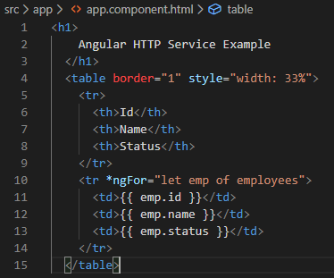
Angular – HttpClient
View HTML Template
Time to update view HTML which will render employee array data as soon as it’s available.

Slide 39
Thank You

